Slide 1
Core Methods in Educational Data Mining
EDUC6191 Fall 2022

Slide 2
The Homework
Let’s go over the homework

Slide 3
Who
Who cross-validated or held out a test set? Who didn't?

Slide 4
Who
Who cross-validated with a student batch? Why?

Slide 5
Tools used
Who used Python?
Who used RapidMiner?
Who used R?
Whose used something else?

Slide 6
Anything clever?
Does anyone in the audience have
Something clever they did and want to share?
Something clever they didn’t do but want to discuss?
A concern about how to do this right?

Slide 7
What mattered?
What could you do to get better model performance?
(Without cheating)

Slide 8
Questions? Comments? Concerns?

Slide 9
A word on data dictionaries
Several of you really really really wanted more information on the variables
It is a good thing to thoroughly understand your variables
It is a good thing to want to thoroughly understand your variables

Slide 10
A word on data dictionaries
In university classes, you will often get excellent descriptions of the data (when it’s not simply made up)
In the real world, outside of national public databases, data dictionaries will often be low-quality or even non-existent
In the real world, variable names will be incomprehensible or – worse yet -- wrong

Slide 11
What could you do?
What are some strategies to use when you get poorly-described data from someone?
Hint: “Ask them to go and write a better data dictionary” almost never works even if you pay them for it

Slide 12
Questions? Comments? Concerns?

Slide 13
Textbook/Readings

Slide 14
Detector Confidence
First, any questions about detector confidence?

Slide 15
Detector Confidence
What is a detector confidence value?

Slide 16
Detector Confidence
What are the pluses and minuses of making sharp distinctions at 50% confidence?

Slide 17
Detector Confidence
Are there real-world cases where it makes sense to have two cut-offs?

Slide 18
Detector Confidence
How would you determine where to place the two cut-offs?

Slide 19
Cost-Benefit Analysis
Why don’t more people do cost-benefit analysis of automated detectors?

Slide 20
Detector Confidence
Is there any way around having intervention cut-offs somewhere?

Slide 21
Goodness Metrics

Slide 22
Exercise
 | Detector Academic Suspension | Detector No Academic Suspension
Data Suspension | 2 | 3
Data No Suspension | 5 | 140
What is accuracy?

Slide 23
Exercise
 | Detector Academic Suspension | Detector No Academic Suspension
Data Suspension | 2 | 3
Data No Suspension | 5 | 140
What is kappa?

Slide 24
Accuracy
Why is it bad?

Slide 25
Kappa
What are its pluses and minuses?

Slide 26
ROC Curve

Slide 27
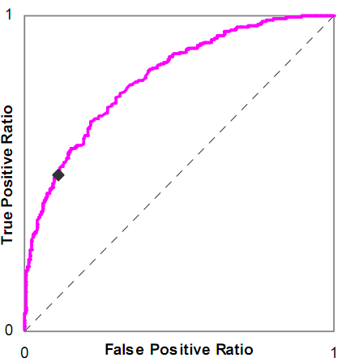
Is this a good model or a bad model?

Slide 28
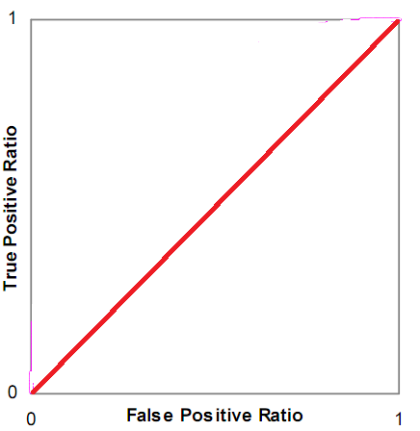
Is this a good model or a bad model?

Slide 29
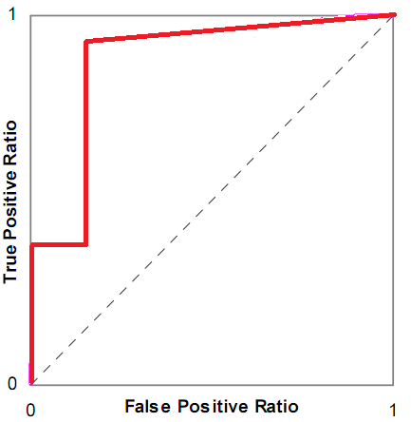
Is this a good model or a bad model?

Slide 30
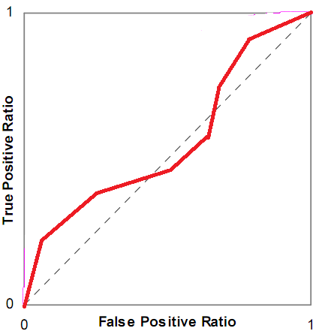
Is this a good model or a bad model?

Slide 31
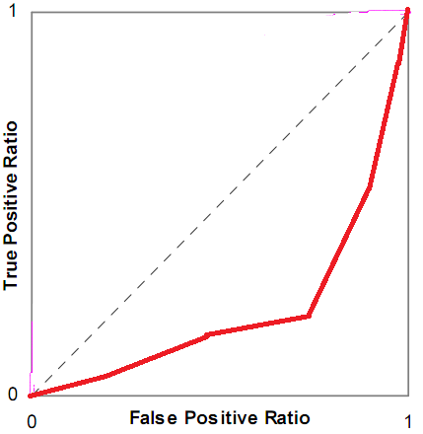
Is this a good model or a bad model?

Slide 32
ROC Curve
What are its pluses and minuses?

Slide 33
AUC ROC
What are its pluses and minuses?

Slide 34
Any questions about AUC ROC?

Slide 35
Precision and Recall
Precision = TP
TP + FP
Recall = TP
TP + FN

Slide 36
Precision and Recall
What do they mean?

Slide 37
What do these mean?
Precision = The probability that a data point classified as true is actually true
Recall = The probability that a data point that is actually true is classified as true

Slide 38
Precision and Recall
What are their pluses and minuses?

Slide 39
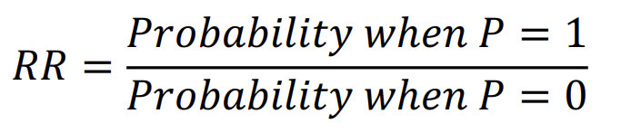
Risk Ratio
Not often used as a measure of detector goodness (but maybe it should be)
Often used to interpret individual features
Used in same situations as odds ratio, but sooooo much better

Slide 40
Risk Ratio: Exercise
Our model detects a student will drop out
If the model says they will drop out, they are 75% likely to drop out
If the model says they won’t drop out, they are 25% likely to drop out

Slide 41
Risk Ratio: Exercise
Our model’s prediction uses as a feature whether they were suspended from school
If they were suspended from school, they are 20% likely to drop out
If they were never suspended, they are 15% likely to drop out

Slide 42
Risk Ratio
Any questions about risk ratio?

Slide 43
Correlation vs RMSE
What is the difference between correlation and RMSE?
What are their relative merits?

Slide 44
What does it mean?
High correlation, low RMSE
Low correlation, high RMSE
High correlation, high RMSE
Low correlation, low RMSE

Slide 45
AIC/BIC vs Cross-Validation
AIC is asymptotically equivalent to LOOCV
BIC is asymptotically equivalent to k-fold cv
Why might you still want to use cross-validation instead of AIC/BIC?
Why might you still want to use AIC/BIC instead of cross-validation?

Slide 46
AIC vs BIC
Any comments or questions?

Slide 47
LOOCV vs k-fold CV
Any comments or questions?

Slide 48
Other questions, comments, concerns about textbook?

Slide 49
Thoughts on the Kitto reading?

Slide 50
Kitto et al.’s warnings
Warning 1. For some educational scenarios, reporting improvement in algorithmic performance is insufficient as a form of validation.
Warning 2. Being able to report upon a metric does not mean that you should use it, either in the tool, or in reporting its worth.
Warning 3. Feedback should not necessarily be set at the same resolution that the analytics make possible.
Warning 4. Overemphasising computational accuracy is likely to delay the adoption of LA tools that could already be used productively.

Slide 51
Please explain why Kitto says these; do you agree?
Warning 1. For some educational scenarios, reporting improvement in algorithmic performance is insufficient as a form of validation.
Warning 2. Being able to report upon a metric does not mean that you should use it, either in the tool, or in reporting its worth.
Warning 3. Feedback should not necessarily be set at the same resolution that the analytics make possible.
Warning 4. Overemphasising computational accuracy is likely to delay the adoption of LA tools that could already be used productively.

Slide 52
Kitto et al.’s suggestion
Once the analytics is embedded in an appropriate learning design we can see that its purpose is to provide enough scaffolding to “start a conversation” between the student and the analytics-driven feedback, or between peers.
What are the pluses and minuses of this framing?

Slide 53
Thoughts on the Knowles reading?

Slide 54
Thoughts on the Jeni reading?

Slide 55
Other questions or comments?

Slide 56
If there is time
Powers quote
“The idea of looking for a single best measure to choose between classifiers is wrongheaded.” – Powers (2012)
Why would Powers say this? Why is this idea mostly ignored in practice?

Slide 57
If there is time
The F1 Statistic

Slide 58
Basic Assignment 2
Diagnostic Metrics
In ASSISTments
This one you can do in Excel, Google Sheets, Matlab, Maple, Python (not particularly recommended)…
Hints are written with Excel in mind

Slide 59
Next classes
September 29 VIRTUAL
Feature Engineering and Distillation
Basic: Diagnostic Metrics Due
October 6
Network Analysis
Creative: Feature Engineering Due
October 13
Bayesian Knowledge Tracing
Basic: SNA Due

